Slide 1


VLSI testing
LAB 1 ATPG and fault simulation (1)
HEP

Slide 2
Exercise 1: Path sensitization
Find test pattern for f/1
a
g
AND 1
b
f
NOT 1
z
NOR1
c
h
i
OR 1
d
NAND 1
e

Slide 3
Exercise 1: Path sensitization
Find test pattern for f/1
a
1
g
AND 1
b
f
D
NOT 1
0
1
z
NOR1
c
D
X
1
h
i
OR 1
d
1
0
NAND 1
1
X
e
1
1

Slide 4
Test pattern data for f/1
Test pattern for f/1: abcde = 11011
Test pattern description file for f/1: c1_pat_f1.ascii
ASCII_PATTERN_FILE_VERSION = 2;
SETUP =
declare input bus "PI" = "/a", "/b", "/c", "/d", "/e”;
declare output bus "PO" = "/z";
end;
SCAN_TEST =
pattern = 0;
force "PI" "11011" 0;
measure "PO" "1" 1;
end;
Expected response z = 1
Test pattern: abcde =11011
Primary output designator
Primary inputs designators

Slide 5
Fault simulation
Fault simulation runfile: fault_sim.run
$TESSENT_PATH/tessent -shell \
-dofile fault_sim.do \
-logfile fault_sim.log -replace
Fault simulation dofile: fault_sim.do
set_context patterns -scan
read_verilog c1.v
set_current_design c1
set_system_mode analysis
// run fault simulation for f/1
set_pattern_source external c1_pat_f1.ascii
add_faults –All
create_patterns
report_statistics
report_faults -class DS
reset state
// run fault simulation for the other faults
// ...

Slide 6
Fault simulation report for f/1
Statistics: fault_sim.log
Detected faults: fault_sim.log
// command: report_statistics
Statistics Report
Stuck-at Faults
-------------------------------------
Fault Classes #faults
(total)
--------------------- --------------
FU (full) 40
------------------- --------------
UC (uncontrolled) 24 (60.00%)
DS (det_simulation) 16 (40.00%)
-------------------------------------
Coverage
-------------------
test_coverage 40.00%
fault_coverage 40.00%
atpg_effectiveness 40.00%
-------------------------------------
#test_patterns 1
#simulated_patterns 1
CPU_time (secs) 1.7
-------------------------------------
// command: report_faults -class DS
type code pin_pathname
---- ------ ------------------------------------
1 DS /not1/OUT
0 EQ /not1/IN
0 EQ /b
1 EQ /and1/IN1
0 DS /d
0 EQ /or1/IN1
0 DS /z
0 EQ /nor1/OUT
1 EQ /nor1/IN0
1 EQ /nor1/IN1
1 EQ /and1/OUT
1 EQ /nand1/OUT
0 EQ /nand1/IN0
0 EQ /nand1/IN1
0 EQ /or1/OUT
0 EQ /e
f/1

Slide 7
Exercise 1: Path sensitization
Find test pattern for h/1
a
g
AND 1
b
f
NOT 1
z
NOR1
c
h
i
OR 1
d
NAND 1
e

Slide 8
Exercise 1: Path sensitization
Find test pattern for h/1
a
0
g
AND 1
b
f
0
NOT 1
0
0
1
z
NOR1
c
D
0
h
i
OR 1
d
0
D
NAND 1
0
e
1
1

Slide 9
Test pattern data for h/1
Test pattern for h/1: abcde = 01001
Test pattern description file for f/1: c1_pat_h1.ascii
ASCII_PATTERN_FILE_VERSION = 2;
SETUP =
declare input bus "PI" = "/a", "/b", "/c", "/d", "/e”;
declare output bus "PO" = "/z";
end;
SCAN_TEST =
pattern = 0;
force "PI” "01001" 0;
measure "PO” "0" 1;
end;
Expected response z = 1
Test pattern: abcde = 01001
Primary output designator
Primary inputs designators

Slide 10
Fault simulation report for h/1
Statistics: fault_sim.log
Detected faults: fault_sim.log
// command: report_statistics
Statistics Report
Stuck-at Faults
-------------------------------------
Fault Classes #faults
(total)
--------------------- --------------
FU (full) 40
------------------- --------------
UC (uncontrolled) 24 (60.00%)
UO (unobserved) 6 (15.00%)
DS (det_simulation) 10 (25.00%)
-------------------------------------
Coverage
-------------------
test_coverage 25.00%
fault_coverage 25.00%
atpg_effectiveness 25.00%
-------------------------------------
#test_patterns 1
#simulated_patterns 1
CPU_time (secs) 1.5
-------------------------------------
// command: report_faults -class DS
type code pin_pathname
---- ------ ------------------------------------
1 DS /or1/OUT
1 EQ /or1/IN0
1 EQ /or1/IN1
1 EQ /c
1 EQ /d
1 EQ /nand1/IN0
0 DS /nand1/OUT
0 EQ /nor1/IN1
1 DS /z
1 EQ /nor1/OUT
h/1

Slide 11
Test pattern generation
ATPG runfile: atpg.run
$TESSENT_PATH/tessent -shell \
-dofile atpg.do \
-logfile atpg.log -replace
ATPG dofile: atpg.do
set_context patterns -scan
read_verilog c1.v
set_current_design c1
set_system_mode analysis
add_faults –All
create_patterns
report_statistics
report_faults -class DS
exit -d

Slide 12
Test pattern generation report
Statistics: atpg.log
// command: report_statistics
Statistics Report
Stuck-at Faults
--------------------------------------
Fault Classes #faults
(total)
--------------------- ---------------
FU (full) 40
------------------- ---------------
DS (det_simulation) 40 (100.00%)
--------------------------------------
Coverage
-------------------
test_coverage 100.00%
fault_coverage 100.00%
atpg_effectiveness 100.00%
--------------------------------------
#test_patterns 7
#simulated_patterns 7
CPU_time (secs) 1.6
--------------------------------------

Slide 13
Exercise 2: Deductive fault simulation
0
a
f
0
1
AND1
b
j
1
g
NOR1
0
c
0
h
0
i
0
1
1
AND2
OR2
z
d
k
0
OR1
e
0
L_{a} = {a₁}
L_{f} = L_{f} - L_{b} U f₁ = {a₁, f₁}
L_{k} = L_{i} U L_{e} U k₁ = {c₁, e₁, i₁, k₁}
L_{b} = {b₀}
L_{g} = {c₁, g₁}
L_{z} = L_{j} - L_{k} U z₀ = {a₁, f₁, g₁, j₀, z₀}
L_{c} = {c₁}
L_{h} = {c₁, h₁}
L_{d} = {d₀}
L_{i} = L_{c} - L_{d} U i₁ = {c₁, i₁}
L_{e} = {e₁}
L_{j} = L_{f} U L_{g} U j₀ = {a₁, c₁, f₁, g₁, j₀}

Slide 14
Test pattern data
Test pattern description file
ASCII_PATTERN_FILE_VERSION = 2;
SETUP =
declare input bus "PI" = "/a", "/b", "/c", "/d", "/e";
declare output bus "PO" = "/z";
end;
SCAN_TEST =
pattern = 0;
force "PI" "01010" 0;
measure "PO" "1" 1;
end;
Expected response z = 1
Test pattern: abcde =01010
Primary output designator
Primary inputs designators

Slide 15
Fault simulation
Fault simulation runfile: fault_sim.run
$TESSENT_PATH/tessent -shell \
-dofile fault_sim.do \
-logfile fault_sim.log -replace
Fault simulation dofile: fault_sim.do
set_context patterns -scan
read_verilog c2.v
set_current_design c2
set_system_mode analysis
// run fault simulation
set_pattern_source external c2_01010_1.pat
add_faults –All
create_patterns
report_statistics
report_faults -class DS
reset_state
// run fault simulation for the other patterns
// ...

Slide 16
Fault simulation report for test: 01010
Statistics: fault_sim.log
Detected faults: fault_sim.log
// command: report_statistics
Statistics Report
Stuck-at Faults
-------------------------------------
Fault Classes #faults
(total)
--------------------- --------------
FU (full) 42
------------------- --------------
UC (uncontrolled) 31 (73.81%)
UO (unobserved) 2 ( 4.76%)
DS (det_simulation) 9 (21.43%)
-------------------------------------
Coverage
-------------------
test_coverage 21.43%
fault_coverage 21.43%
atpg_effectiveness 21.43%
-------------------------------------
#test_patterns 1
#simulated_patterns 1
CPU_time (secs) 1.7
-------------------------------------
// command: report_faults -class DS
type code pin_pathname
---- ------ ------------------------------------
1 DS /a
1 EQ /and1/IN0
0 DS /nor1/OUT
1 EQ /nor1/IN0
1 EQ /nor1/IN1
1 EQ /and1/OUT
0 EQ /or2/IN0
0 DS /z
0 EQ /or2/OUT
a/1
j/0
f/1
g/1
j/0
z/0

Slide 17
VLSI testing
LAB 2 ATPG and fault simulation (2)
HEP

Slide 18
Exercise 1: Test set minimization
a
h
f
OR 1
b
e
z
c
AND 1
AND 2
g
i
NOR 1
d

Slide 19
Fault table for all stuck-at faults
 | Faults
Tests | abcd | a/0 | a/1 | b/0 | b/1 | c/0 | c/1 | d/0 | d/1 | e/0 | e/1 | f/0 | f/1 | g/0 | g/1 | h/0 | h/1 | i/0 | i/1 | z/0 | z/1
 | 0000
 | 0001
 | 0010
 | 0011
 | 0100
 | 0101
 | 0110
 | 0111
 | 1000
 | 1001
 | 1010
 | 1011
 | 1100
 | 1101
 | 1110
 | 1111

Slide 20
Fault simulation report for test: 0000
Statistics: fault_sim.log
Detected faults: fault_sim.log
// command: report_statistics
Statistics Report
Stuck-at Faults
-------------------------------------
Fault Classes #faults
(total)
--------------------- --------------
FU (full) 42
------------------- --------------
UC (uncontrolled) 31 (73.81%)
UO (unobserved) 2 ( 4.76%)
DS (det_simulation) 9 (21.43%)
-------------------------------------
Coverage
-------------------
test_coverage 21.43%
fault_coverage 21.43%
atpg_effectiveness 21.43%
-------------------------------------
#test_patterns 1
#simulated_patterns 1
CPU_time (secs) 1.7
-------------------------------------
// command: report_faults -class DS
type code pin_pathname
---- ------ ------------------------------------
1 DS /a
1 EQ /and1/IN0
0 DS /nor1/OUT
1 EQ /nor1/IN0
1 EQ /nor1/IN1
1 EQ /and1/OUT
0 EQ /or2/IN0
0 DS /z
0 EQ /or2/OUT

Slide 21
Fault table for all stuck-at faults
 | Faults
Tests | abcd | a/0 | a/1 | b/0 | b/1 | c/0 | c/1 | d/0 | d/1 | e/0 | e/1 | f/0 | f/1 | g/0 | g/1 | h/0 | h/1 | i/0 | i/1 | z/0 | z/1
 | 0000
 | 0001
 | 0010
 | 0011
 | 0100
 | 0101
 | 0110
 | 0111
 | 1000
 | 1001
 | 1010
 | 1011
 | 1100
 | 1101
 | 1110
 | 1111

Slide 22
Fault table for all stuck-at faults
 | Faults
Tests | abcd | a/0 | a/1 | b/0 | b/1 | c/0 | c/1 | d/0 | d/1 | e/0 | e/1 | f/0 | f/1 | g/0 | g/1 | h/0 | h/1 | i/0 | i/1 | z/0 | z/1
 | 0000
 | 0001
 | 0010
 | 0011
 | 0100
 | 0101
 | 0110
 | 0111
 | 1000
 | 1001
 | 1010
 | 1011
 | 1100
 | 1101
 | 1110
 | 1111

Slide 23
Fault equivalence classes
F₁ = {a/0, d/1, e/1, g/1, h/0, i/0, z/0}
F₂ = {a/1, f/1, h/1}
F₃ = {b/0, c/0, e/0}
F₄ = {b/1}
F₅ = {c/1}
F₆ = {d/0}
F₇ = {f/0}, undetectable fault
F₈ = {g/0}
F₉ = {i/1}
F₁₀ = {z/1}
Reduction = 10/20

Slide 24
Reduced fault table
 | Faults
Tests | abcd | a/0 | a/1 | b/0 | b/1 | c/1 | d/0 | g/0 | i/1 | z/1
 | 0000
 | 0001
 | 0010
 | 0011
 | 0100
 | 0101
 | 0110
 | 0111
 | 1000
 | 1001
 | 1010
 | 1011
 | 1100
 | 1101
 | 1110
 | 1111

Slide 25
Reduced fault table
 | Faults
Tests | abcd | a/0 | a/1 | b/0 | b/1 | c/1 | d/0 | g/0 | i/1 | z/1
 | 0000 |  |  |  |  |  |  |  |  |  | Selected
 | 0001
 | 0010
 | 0011
 | 0100
 | 0101
 | 0110
 | 0111
 | 1000
 | 1001 |  |  |  |  |  |  |  |  |  | Selected
 | 1010 |  |  |  |  |  |  |  |  |  | Essential
 | 1011
 | 1100 |  |  |  |  |  |  |  |  |  | Essential
 | 1101
 | 1110 |  |  |  |  |  |  |  |  |  | Essential
 | 1111
The minimal test set:
0000
1001
1010
1100
1110
The minimum number of tests = 5

Slide 26
VLSI testing
LAB 3 ATPG and fault simulation (3)
HEP

Slide 27
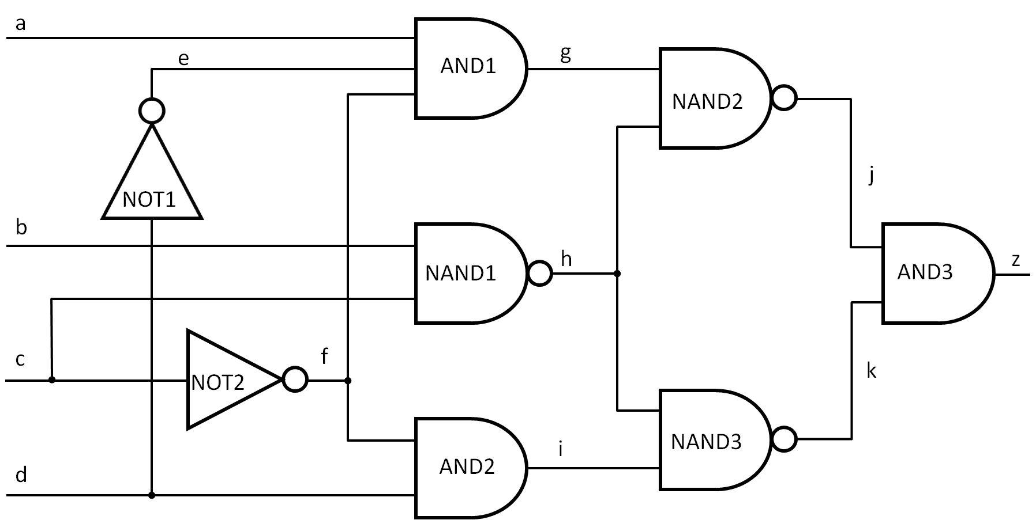
Exercise 1: Removal of redundancy

Slide 28
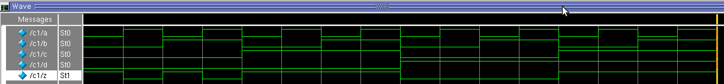
Simulation of redundant circuit

Slide 29
ATPG report
Statistics
Redundant faults
// command: report_statistics
Statistics Report
Stuck-at Faults
-------------------------------------
Fault Classes #faults
(total)
--------------------- --------------
FU (full) 56
------------------- --------------
DS (det_simulation) 45 (80.36%)
RE (redundant) 11 (19.64%)
-------------------------------------
Coverage
-------------------
test_coverage 100.00%
fault_coverage 80.36%
atpg_effectiveness 100.00%
-------------------------------------
#test_patterns 5
#simulated_patterns 6
CPU_time (secs) 1.5
-------------------------------------
// command: report_faults -class RE
type code pin_pathname
---- ------ ------------------------------------
1 RE /NAND1/OUT
0 EQ /NAND1/IN0
0 EQ /NAND1/IN1
0 EQ /b
1 RE /b
1 EQ /NAND1/IN0
1 RE /NOT1/OUT
0 EQ /NOT1/IN
1 EQ /AND1/IN1
1 RE /NAND3/IN0
1 RE /NAND2/IN1

Slide 30
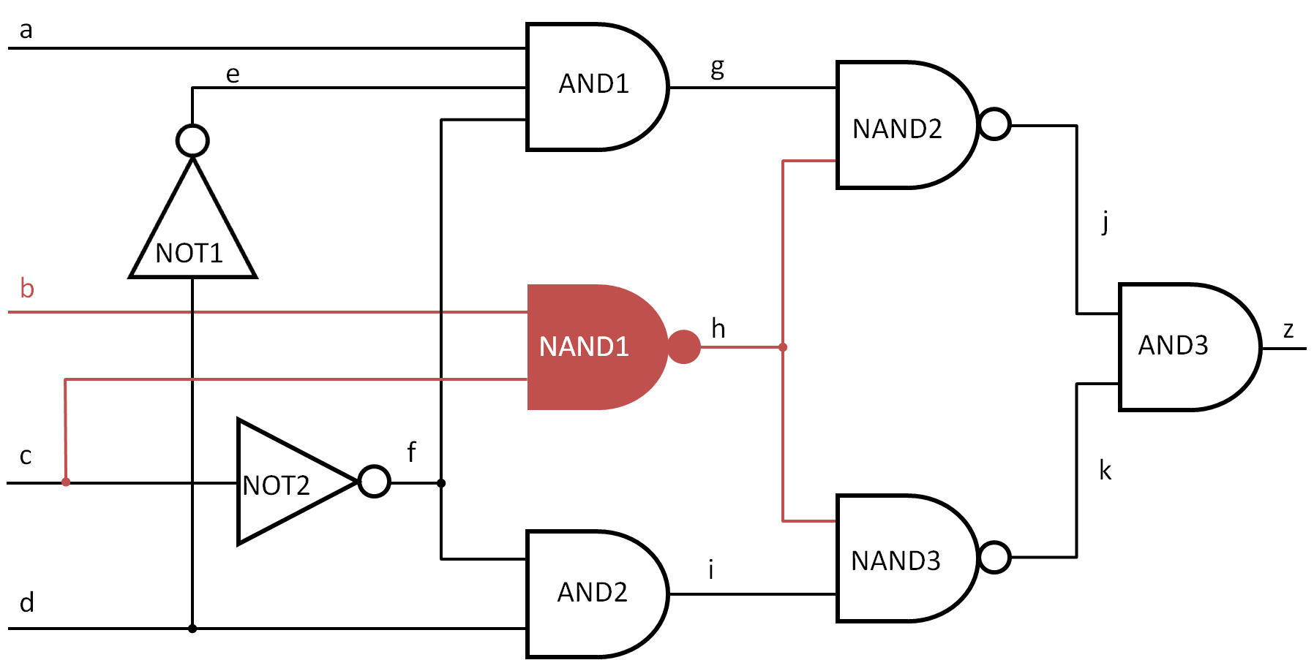
Redundant logic

Slide 31
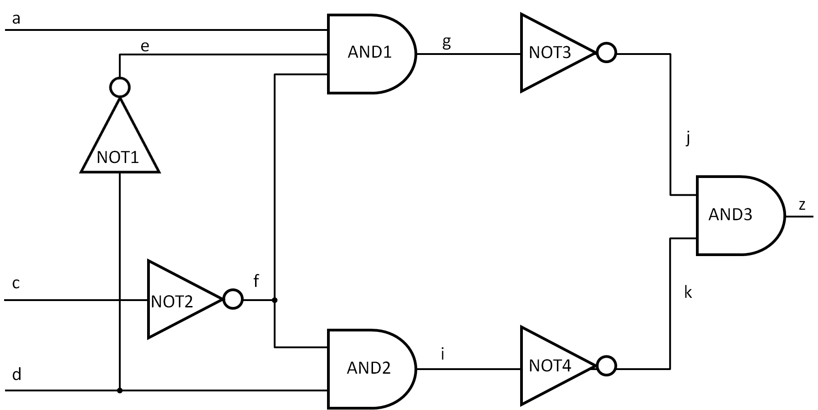
After modification

Slide 32
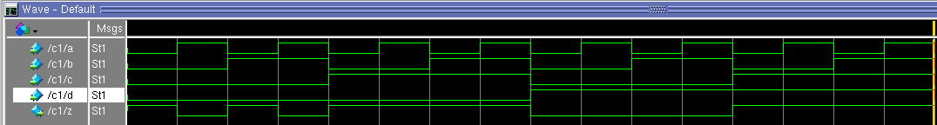
Comparison of waveforms

Slide 33
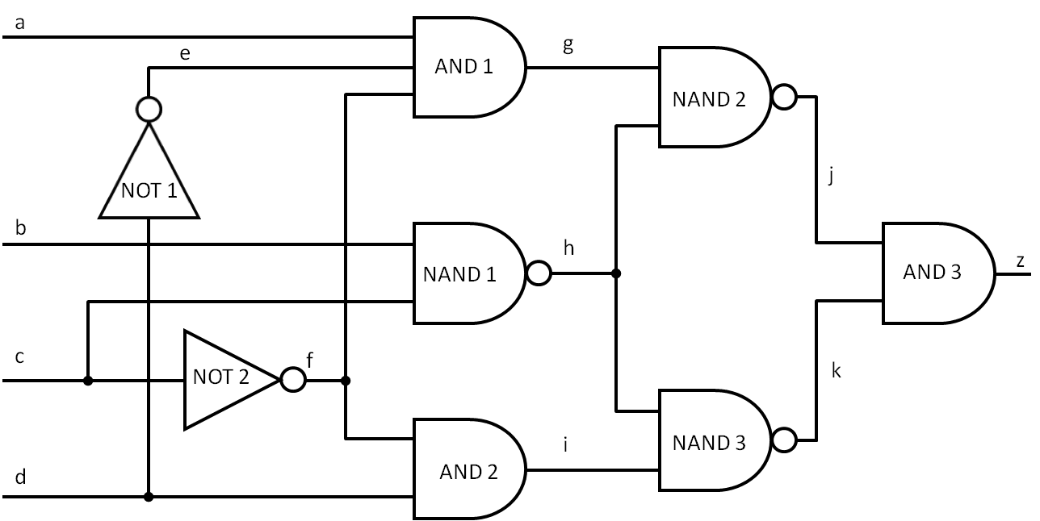
Exercise 2: Test point insertion

Slide 34
ATPG report
Statistics
Redundant faults
// command: report_statistics
Statistics Report
Stuck-at Faults
-------------------------------------
Fault Classes #faults
(total)
--------------------- --------------
FU (full) 56
------------------- --------------
DS (det_simulation) 45 (80.36%)
RE (redundant) 11 (19.64%)
-------------------------------------
Coverage
-------------------
test_coverage 100.00%
fault_coverage 80.36%
atpg_effectiveness 100.00%
-------------------------------------
#test_patterns 5
#simulated_patterns 6
CPU_time (secs) 1.2
-------------------------------------
// command: report_faults -class RE
type code pin_pathname
---- ------ ------------------------------------
1 RE /NAND1/OUT
0 EQ /NAND1/IN0
0 EQ /NAND1/IN1
0 EQ /b
1 RE /b
1 EQ /NAND1/IN0
1 RE /NOT1/OUT
0 EQ /NOT1/IN
1 EQ /AND1/IN1
1 RE /NAND3/IN0
1 RE /NAND2/IN1

Slide 35
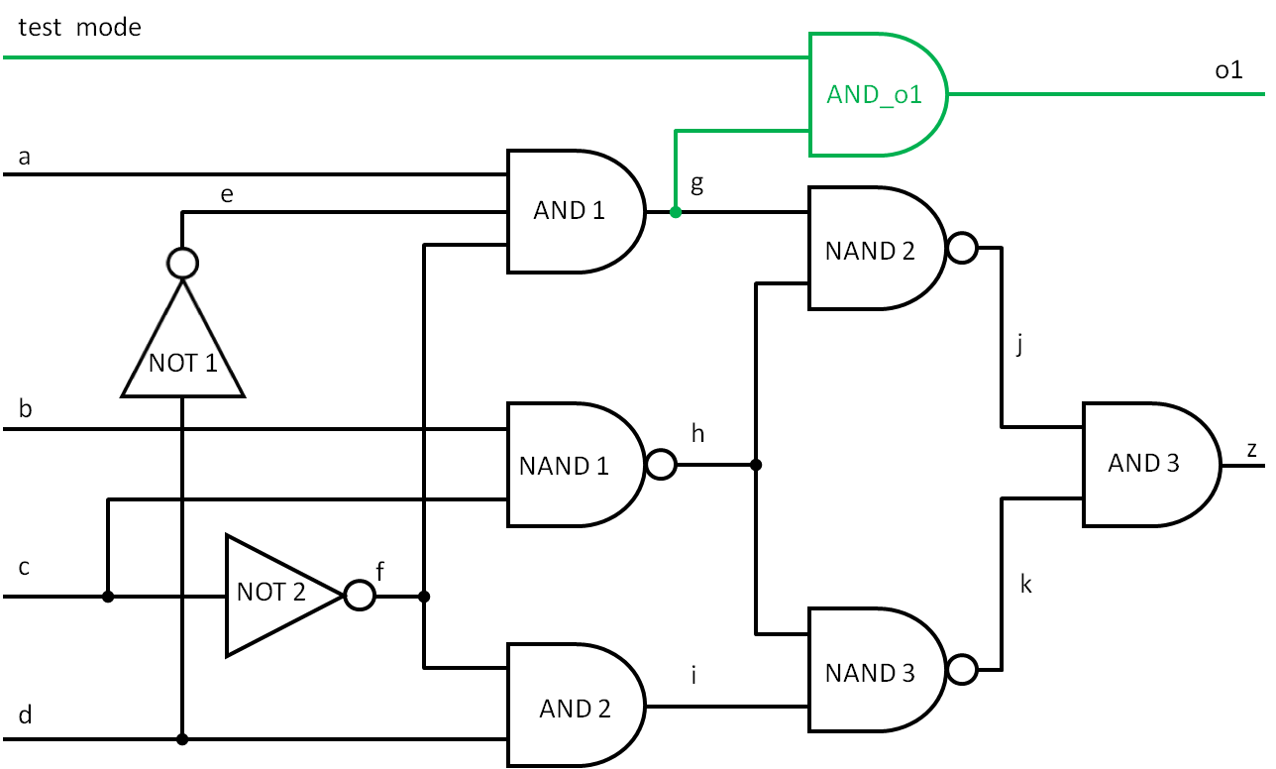
New observation point

Slide 36
ATPG report
Statistics
Redundant faults
// command: report_statistics
Statistics Report
Stuck-at Faults
-------------------------------------
Fault Classes #faults
(total)
--------------------- --------------
FU (full) 66
------------------- --------------
DS (det_simulation) 58 (87.88%)
RE (redundant) 8 (12.12%)
-------------------------------------
Coverage
-------------------
test_coverage 100.00%
fault_coverage 87.88%
atpg_effectiveness 100.00%
-------------------------------------
#test_patterns 6
#simulated_patterns 8
CPU_time (secs) 1.2
-------------------------------------
// command: report_faults -class RE
type code pin_pathname
---- ------ ------------------------------------
1 RE /NAND1/OUT
0 EQ /NAND1/IN0
0 EQ /NAND1/IN1
0 EQ /b
1 RE /b
1 EQ /NAND1/IN0
1 RE /NAND3/IN0
1 RE /NAND2/IN1

Slide 37
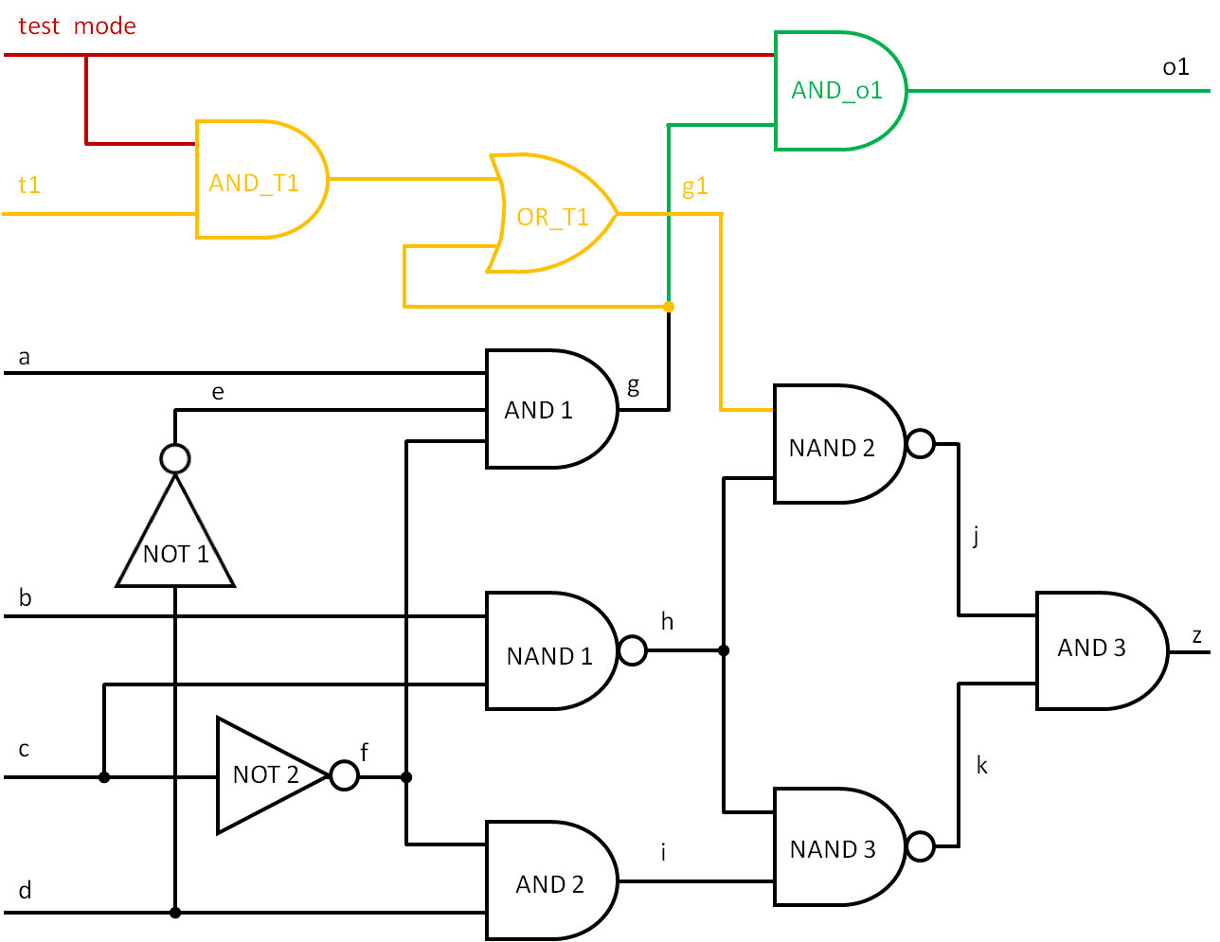
New test points

Slide 38
ATPG report
Statistics
Redundant faults
// command: report_statistics
Statistics Report
Stuck-at Faults
-------------------------------------
Fault Classes #faults
(total)
--------------------- --------------
FU (full) 80
------------------- --------------
DS (det_simulation) 79 (98.75%)
RE (redundant) 1 ( 1.25%)
-------------------------------------
Coverage
-------------------
test_coverage 100.00%
fault_coverage 98.75%
atpg_effectiveness 100.00%
-------------------------------------
#test_patterns 10
#simulated_patterns 10
CPU_time (secs) 1.2
-------------------------------------
// command: report_faults -class RE
type code pin_pathname
---- ------ ------------------------------------
1 RE /NAND3/IN0

Slide 39
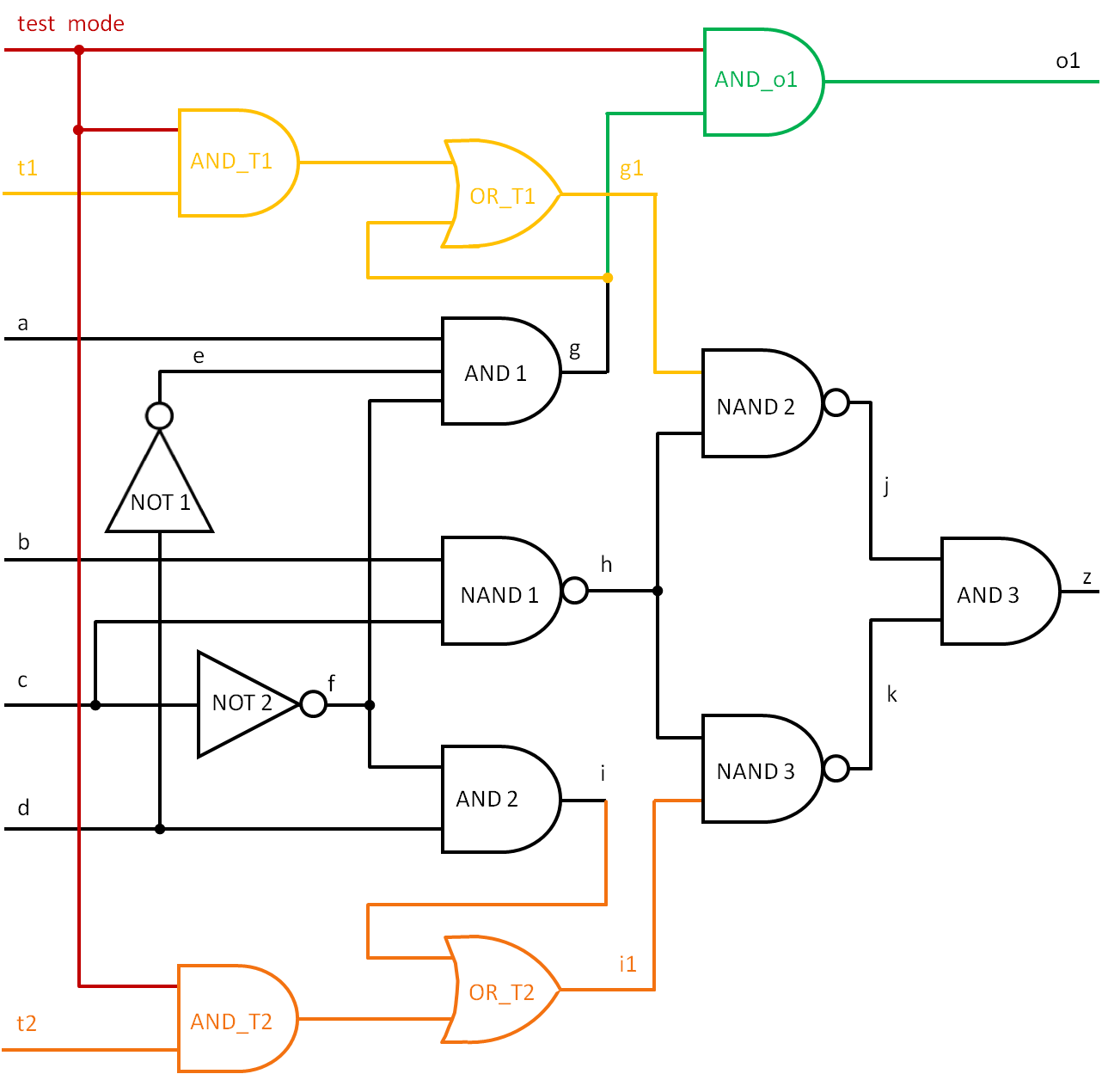
Circuit with test points

Slide 40
ATPG report
Statistics
Redundant faults
// command: report_statistics
Statistics Report
Stuck-at Faults
--------------------------------------
Fault Classes #faults
(total)
--------------------- ---------------
FU (full) 94
------------------- ---------------
DS (det_simulation) 94 (100.00%)
--------------------------------------
Coverage
-------------------
test_coverage 100.00%
fault_coverage 100.00%
atpg_effectiveness 100.00%
--------------------------------------
#test_patterns 13
#simulated_patterns 13
CPU_time (secs) 1.2
--------------------------------------
// command: report_faults -class RE
type code pin_pathname
---- ------ ------------------------------------
// Warning: No faults reported.

Slide 41
VLSI testing
LAB 4
Pseudorandom testing
HEP

Slide 42
Fibonacci LFSR
a
b
c
d

Slide 43
Fibonacci LFSR
a
b
c
d
0
0
0
1

Slide 44
Fibonacci LFSR
a
b
c
d
0
1
0
0
1
1
0
1
0
1
1
1
1
0
0
0
0
1
0
0
1
1
0
1
0
1
1
1
1
0
0
0
0
1
0
0
1
1
0
1
0
1
1
1
1
1
0
0
0
1
0
0
1
1
0
1
0
1
1
0

Slide 45
Galois LFSR
a
b
c
d

Slide 46
Galois LFSR
a
b
c
d
0
0
0
1

Slide 47
Galois LFSR
a
b
c
d
0
1
2
3
4
5
6
7
8
9
10
11
12
13
14
0
1
1
1
1
0
1
0
1
1
0
0
1
0
0
0
0
1
1
1
1
0
1
0
1
1
0
0
1
0
0
0
0
1
0
0
1
1
0
1
0
1
1
1
1
1
1
1
1
0
1
0
1
1
0
0
1
0
0
0

Slide 48
Exercise 2
Select a proper primitive polynomial from Appendix 3
1
2
.
.
.
CUT
c6288
Test pattern generator
32

Slide 49
Fault coverage
# test patterns | # effective patterns | # detected faults | fault coverage
1
10
20
30
40
50
60
70
80
90
100
1000
10000
100000

Slide 50
Fault coverage
Use the following command to extract the required statistics:
egrep "test_patterns|simulated_patterns|fault_coverage" c6288.log
fault_coverage 33.41%
#test_patterns 1
#simulated_patterns 1
fault_coverage 60.80%
#test_patterns 10
#simulated_patterns 10
fault_coverage 72.00%
#test_patterns 20
#simulated_patterns 20
fault_coverage 79.82%
#test_patterns 30
#simulated_patterns 30
fault_coverage 87.77%
#test_patterns 39
#simulated_patterns 40

Slide 51
Fault coverage
# test vectors | fault coverage | # detected faults
1 | 33.41% | 4864
10 | 60.80% | 8853
20 | 72.00% | 10483
30 | 79.82% | 11622
40 | 87.77% | 12780
50 | 93.63% | 13632
60 | 97.31% | 14169
70 | 98.27% | 14308
80 | 98.98% | 14412
90 | 99.27% | 14454
100 | 99.29% | 14456

Slide 52
VLSI testing
LAB 5
Design for testability (DFT)
HEP

Slide 53
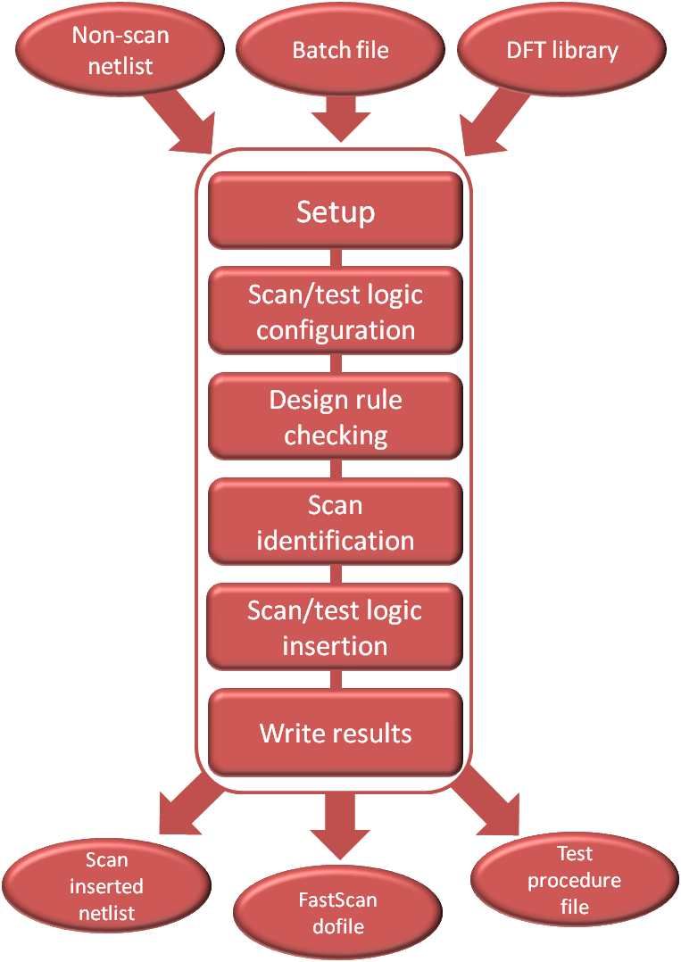
Exercise 1: Scan insertion flow

Slide 54
Leonardo Spectrum – design synthesis
Leonardo Spectrum dofile
load_library ../libs/ami05_worst.syn
read ../netlists/RTL/package_g12.vhd
read ../netlists/RTL/proc_timer.vhd
read ../netlists/RTL/proc_mv_sec.vhd
read ../netlists/RTL/proc_mux_z8.vhd
read ../netlists/RTL/proc_col_sec.vhd
read ../netlists/RTL/proc_fcomp_sec.vhd
read ../netlists/RTL/proc_comb_sec.vhd
read ../netlists/RTL/proc_block_match.vhd
optimize
report_area -cell
apply_rename_rules -ruleset VERILOG
auto_write ../netlists/top.gate.v
Leonardo Spectrum run file
$LEONARDO_SPECTRUM_PATH/spectrum -file spectrum.batch \
-logfile ../logs/0_spec_synth.log

Slide 55
Tessent Scan – scan chains insertion
Tessent Scan dofile
read_cell_library ../libs/atpg.lib
// Go to DFT mode
set_context dft -scan
read_verilog ../netlists/top.gate.v
analyze_control_signals –auto
// Insert scan chains
set_system_mode analysis
insert_test_logic -number 100
report_scan_chains
// Write netlist and setup files for ATPG
write_design -output_file ../netlists/gate_scan.v -replace
write_atpg_setup ./atpg -replace -procfile
exit
Tessent Scan run file
$TESSENT_PATH/tessent -shell \
-dofile dfta.do \
-log ../logs/dfta.log -replace

Slide 56
Exercise 2: Test generation flow

Slide 57
Tessent Scan – scan chains insertion
Tessent Scan dofile
read_cell_library ../libs/atpg.lib
// Go to DFT mode
set_context dft -scan
read_verilog ../netlists/cpu.v
analyze_control_signals -auto
// Insert scan chains
set_system_mode analysis
insert_test_logic -scan on -number 4
report_scan_chains
report_scan_cells
// Write netlist and setup files for ATPG
write_design -output_file ../netlists/cpu_scan.v -replace
write_atpg_setup ../2_atpg/atpg_setup -replace
exit
Tessent Scan run file
$TESSENT_PATH/tessent –shell \
-dofile insert_scan.do \
-logfile insert_scan.log -replace

Slide 58
FastScan – test pattern generation
Tessent FastScan dofile
read_cell_library ../libs/atpg.lib
set_context patterns -scan
read_verilog ../netlists/cpu_scan.v
set_current_design cpu
// Read atpg setup
dofile atpg_setup.dofile
// Go to atpg mode
set_system_mode analysis
// Pattern generation, default is stuck-at
create_patterns
report_statistics
// Save parallel and serial verilog patterns for simulation
write_patterns ../3_vsim/pat_stuck_par.v –verilog \
-parallel -replace
write_patterns ../3_vsim/pat_stuck_ser.v –verilog \
-begin 0 -end 2 -serial -rep
exit
Tessent FastScan run file
$TESSENT_PATH/tessent –shell
-dofile atpg.do
-logfile atpg.log -replace

Slide 59
VLSI testing
LAB 6
Built-in Self-Test (BIST)
HEP

Slide 60
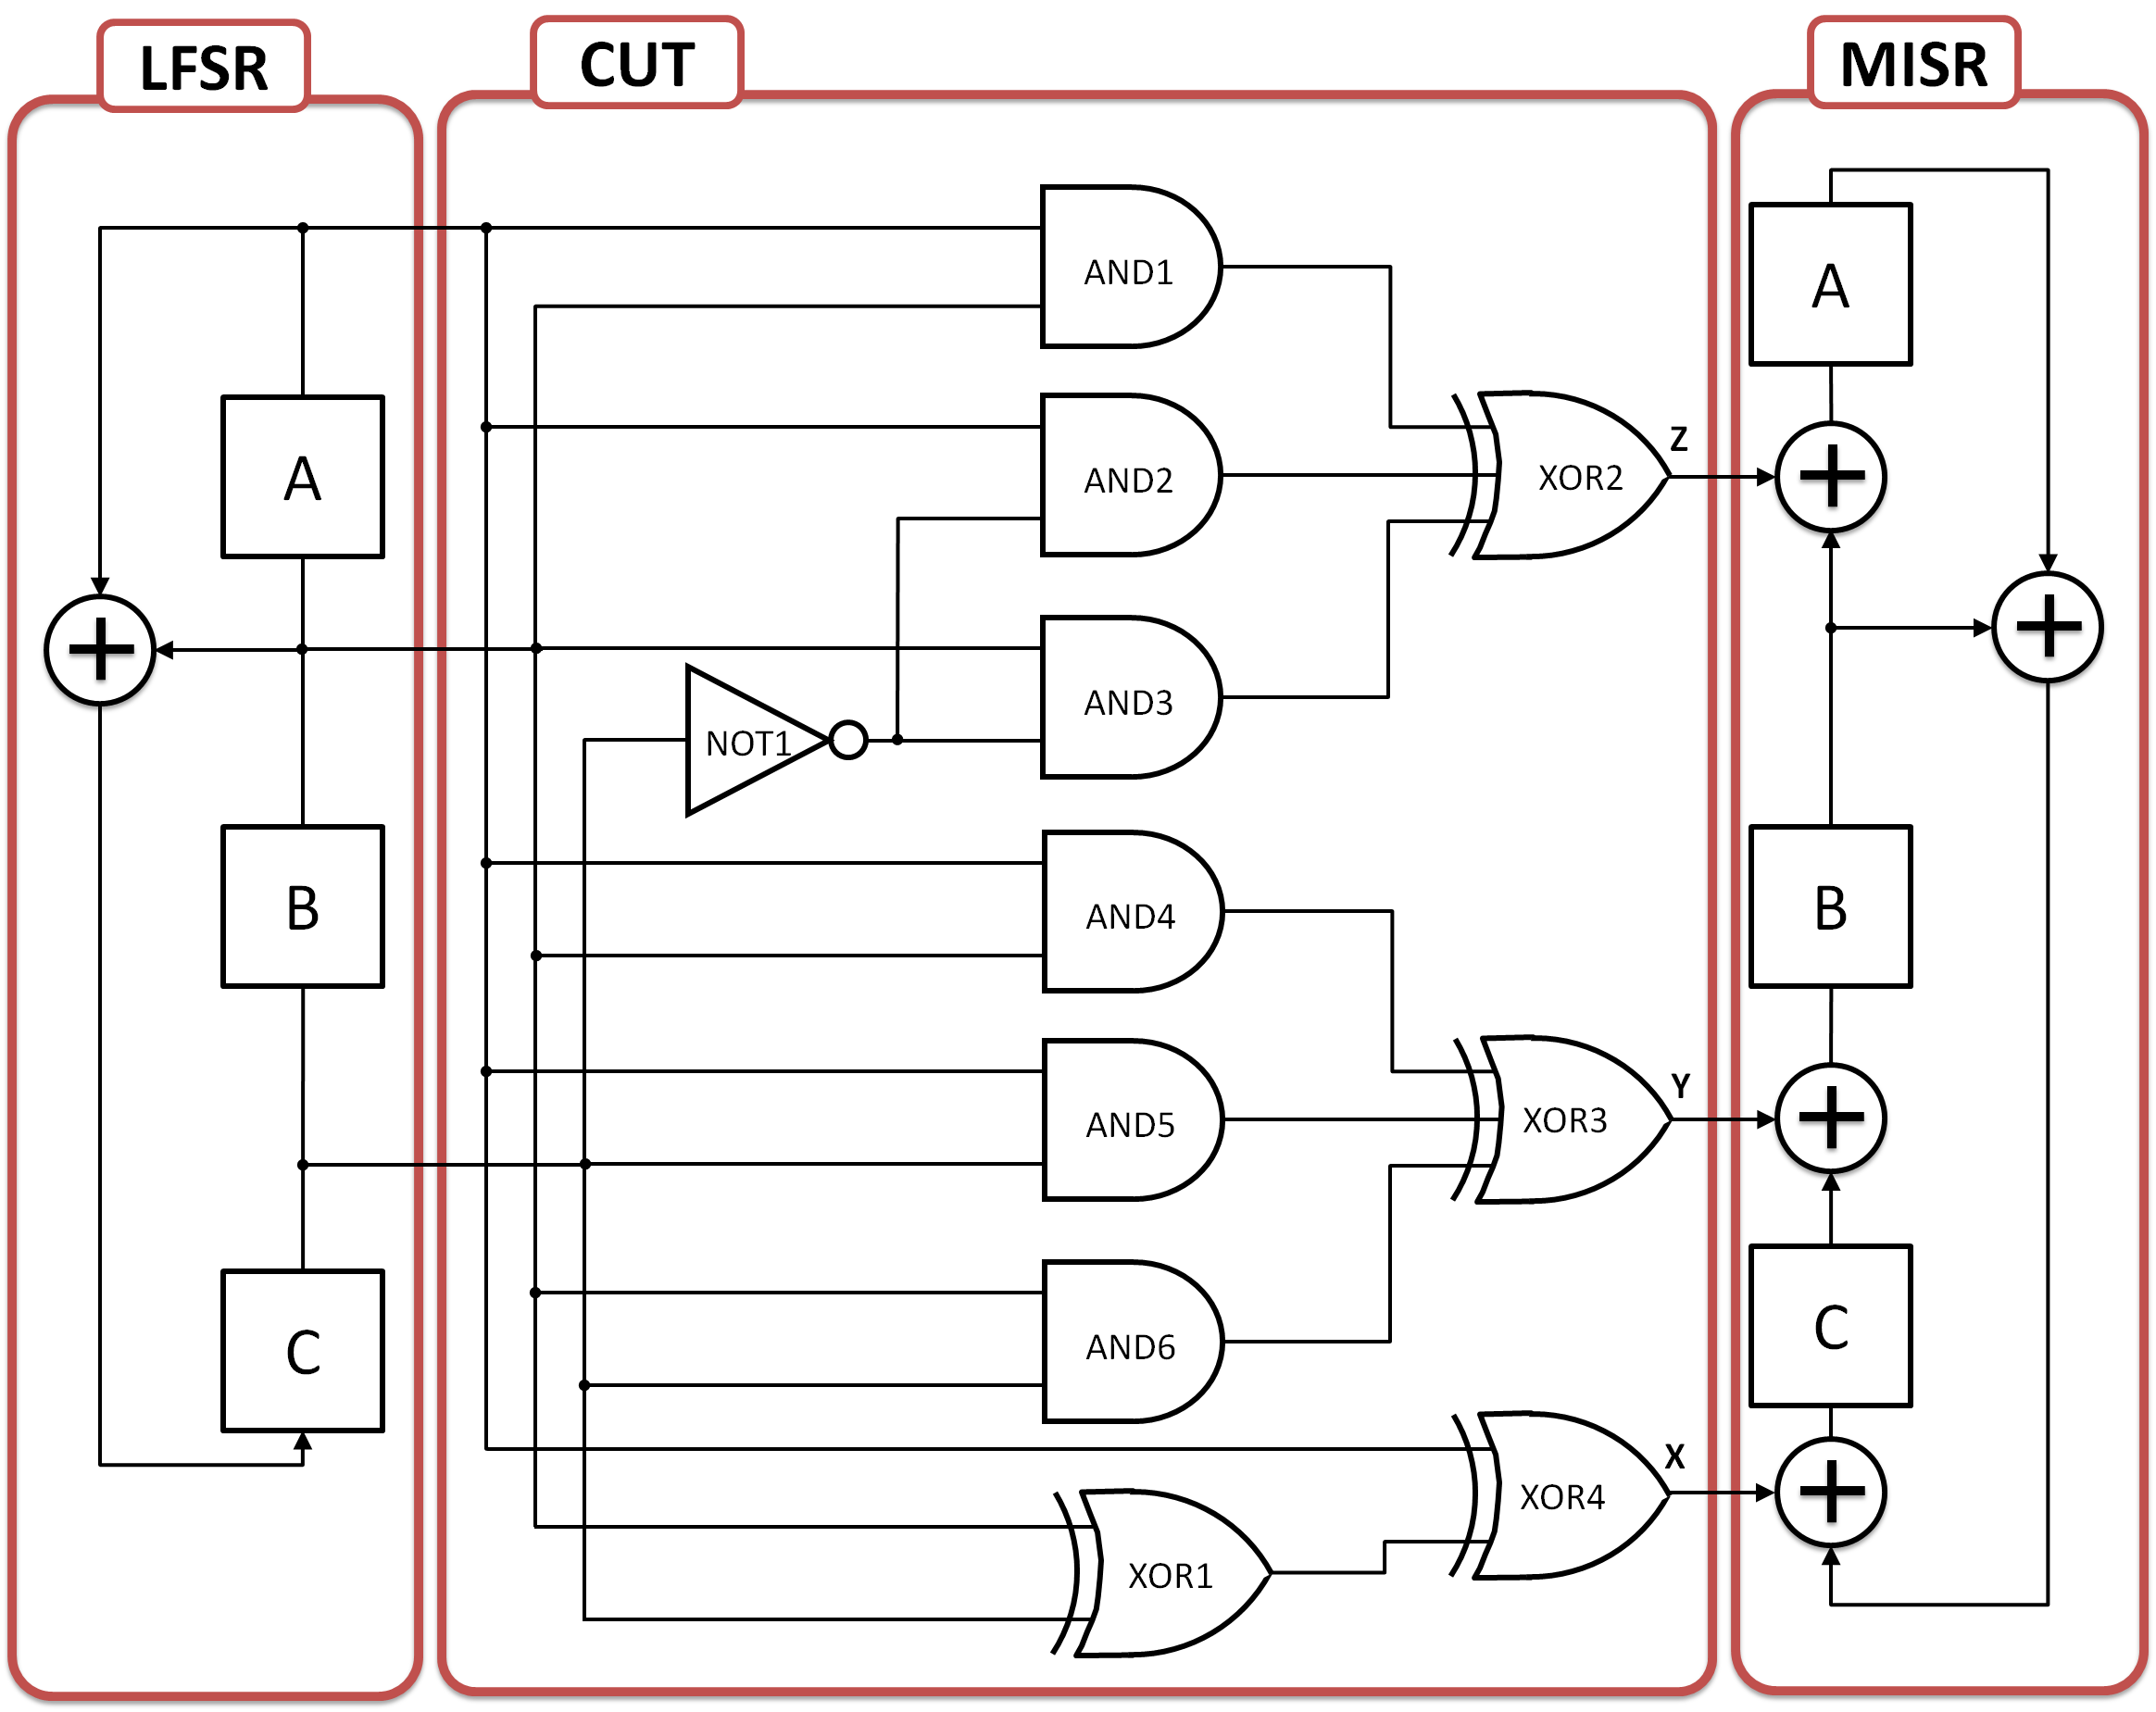
Exercise 1: BIST

Slide 61
BIST
Fault-free circuit |  |  | Fault A/0 |  | Fault A/1
LFSR | Circuit output | MISR | Circuit output | MISR | Circuit output | MISR
ABC | XYZ | ABC | XYZ | ABC | XYZ | ABC
001 |  | 000 |  | 000 |  | 000

Slide 62
BIST
Fault-free circuit |  |  | Fault A/0 |  | Fault A/1
LFSR | Circuit output | MISR | Circuit output | MISR | Circuit output | MISR
ABC | XYZ | ABC | XYZ | ABC | XYZ | ABC
001 |  | 000 |  | 000 |  | 000
010
101
011
111
110
100
001

Slide 63
BIST
Fault-free circuit |  |  | Fault A/0 |  | Fault A/1
LFSR | Circuit output | MISR | Circuit output | MISR | Circuit output | MISR
ABC | XYZ | ABC | XYZ | ABC | XYZ | ABC
001 | 100 | 000 |  | 000 |  | 000
010 | 101
101 | 010
011 | 010
111 | 111
110 | 011
100 | 101
001 | 100

Slide 64
BIST
Fault-free circuit |  |  | Fault A/0 |  | Fault A/1
LFSR | Circuit output | MISR | Circuit output | MISR | Circuit output | MISR
ABC | XYZ | ABC | XYZ | ABC | XYZ | ABC
001 | 100 | 000 |  | 000 |  | 000
010 | 101 | 001
101 | 010 | 111
011 | 010 | 100
111 | 111 | 011
110 | 011 | 000
100 | 101 | 110
001 | 100 | 001
fault-free signature

Slide 65
BIST
Fault-free circuit |  |  | Fault A/0 |  | Fault A/1
LFSR | Circuit output | MISR | Circuit output | MISR | Circuit output | MISR
ABC | XYZ | ABC | XYZ | ABC | XYZ | ABC
001 | 100 | 000 | 000 | 000 |  | 000
010 | 101 | 001 | 101 | 000
101 | 010 | 111 | 101 | 101
011 | 010 | 100 | 101 | 110
111 | 111 | 011 | 011 | 001
110 | 011 | 000 | 011 | 100
100 | 101 | 110 | 101 | 111
001 | 100 | 001 | 000 | 011
fault-free signature
signature for fault A/0

Slide 66
BIST
Fault-free circuit |  |  | Fault A/0 |  | Fault A/1
LFSR | Circuit output | MISR | Circuit output | MISR | Circuit output | MISR
ABC | XYZ | ABC | XYZ | ABC | XYZ | ABC
001 | 100 | 000 | 000 | 000 | 100 | 000
010 | 101 | 001 | 101 | 000 | 010 | 001
101 | 010 | 111 | 101 | 101 | 010 | 000
011 | 010 | 100 | 101 | 110 | 010 | 010
111 | 111 | 011 | 011 | 001 | 111 | 111
110 | 011 | 000 | 011 | 100 | 111 | 001
100 | 101 | 110 | 101 | 111 | 010 | 101
001 | 100 | 001 | 000 | 011 | 100 | 001
aliasing – circuit with fault A/1 classified as fault-free
fault-free signature
signature for fault A/0
signature for fault A/1

Slide 67
VLSI testing
LAB 7
Test Compression
HEP

Slide 68
Exercise 1: Test compression flow

Slide 69
Leonardo Spectrum – design synthesis
Leonardo Spectrum dofile
load_library ../libs/ami05_worst.syn
read ../netlists/alu.v
read ../netlists/dram.v
read ../netlists/regs.v
read ../netlists/idec.v
read ../netlists/cpu.v
optimize
report_area -cell
report_delay
set vhdl_write_use_packages {library ieee,adk; \ use ieee.std_logic_1164.all; \
use adk.adk_components.all; }
apply_rename_rules -ruleset VHDL
apply_rename_rules -ruleset VERILOG
auto_write ../netlists/cpu_gate.v
Leonardo Spectrum run file
$LEONARDO_SPECTRUM_PATH/spectrum -file spectrum.batch \
-logfile ../logs/0_spec_synth.log

Slide 70
Tessent Scan – scan insertion
Tessent Scan dofile
read_cell_library ../libs/atpg.lib
// Go to DFT mode
set_context dft -scan
read_verilog ../netlists/cpu_gate.v
analyze_control_signals -auto
// Insert scan chains
set_system_mode analysis
// Insert scan and ensure dedicated scan output pins
insert_test_logic -scan on -number 20
report_scan_chains
// Write netlist and setup files for Tessent FastScan
// and TestKompress
write_design -output_file ../netlists/cpu_scan.v -replace
write_atpg_setup ../2_fs_pg/cpu_scan -replace
write_atpg_setup ../3_tk_edt/cpu_scan -replace
exit
Tessent Scan run file
$TESSENT_PATH/tessent -shell \
-dofile insert_scan.do \
-logfile ../logs/1_insert_scan.log \ -replace

Slide 71
TestKompress – test generation
Tessent TestKompress dofile
read_cell_library ../libs/atpg.lib
set_context patterns -scan
read_verilog ../netlists/cpu_scan.v
set_current_design cpu
// Read atpg setup
dofile cpu_scan.dofile
// Go to atpg mode
set_system_mode analysis
// Pattern generation, default is stuck-at
create_patterns
report_statistics
exit -d
Tessent TestKompress run file
$TESSENT_PATH/tessent -shell \
-dofile atpg.do \
-logfile ../logs/2_atpg.log \
-replace

Slide 72
TestKompress – EDT logic
Tessent TestKompress dofile
read_cell_library ../libs/atpg.lib
set_context dft -edt
read_verilog ../netlists/cpu_scan.v
set_current_design cpu
// Read atpg setup
dofile cpu_scan.dofile
//Settings for EDT
set_edt_options -input_channels 4 -output_channels 4
// Go to atpg mode
set_system_mode analysis
// Create Patterns as a sanity check to make sure that
// you are getting the same coverage as FastScan
create_patterns
// Save the EDT logic and write out the synthesis
// scripts.
write_edt_files ../5_tk_pg/cpu_edt -verilog -replace
exit -d
Tessent TestKompress run file
$TESSENT_PATH/tessent –shell \
-dofile tk_logic.do \
-logfile ../logs/3_tk_logic.log \
-replace

Slide 73
Leonardo Spectrum – test logic synthesis
Leonardo Spectrum dofile
load_library ../libs/ami05_worst.syn
read ../netlists/cpu_scan.v
read ../5_tk_pg/cpu_edt_edt.v
read ../5_tk_pg/cpu_edt_edt_top.v
optimize -ef remap -ta ami05_worst -macro -hier preserve
write ../netlists/cpu_top_gate.v
Leonardo Spectrum run file
$TESSENT_PATH/spectrum \
-file spectrum.batch \
-logfile ../logs/4_spec_synth.log

Slide 74
TestKompress – test generation
Tessent TestKompress dofile
read_cell_library ../libs/atpg.lib
set_context patterns -scan
set_edt on
read_verilog ../netlists/cpu_top_gate.v
set_current_design cpu_edt_top
// Define scan chains and control signals
// use file created by Tessent TestKompress during
// RTL generation
dofile ./cpu_edt_edt.dofile
set_system_mode analysis
report_edt_configuration
// Add faults only to the core
add_faults cpu_i
// Generate patterns
create_patterns
// Report statistics
report_scan_volume
// Save out pattern
write_patterns patterns_edt.ascii -ascii -replace
exit -discard
Tessent TestKompress run file
$TESSENT_PATH/tessent -shell
-dofile tk_pg.do \
-logfile ../logs/5_tk_pg.log \
-replace

Slide 75
VLSI testing
LAB 8 Fault diagnosis
HEP

Slide 76
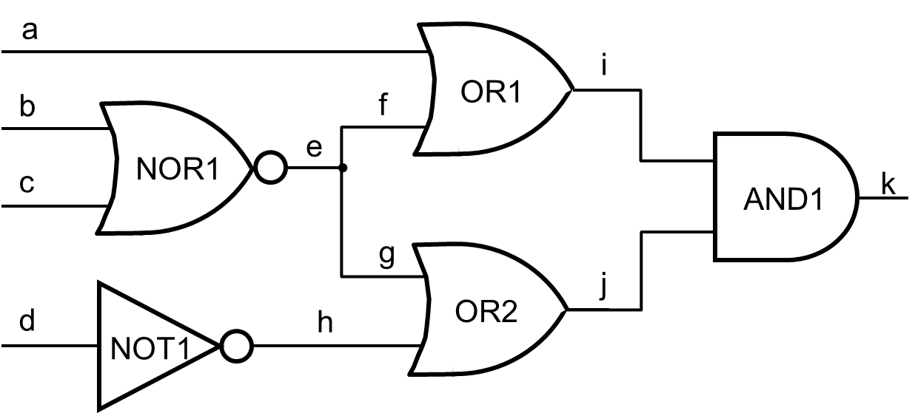
Exercise 1: Logic-level diagnosis
Generate test patterns for circuit c1

Slide 77
Test pattern generation
Tessent FastScan run file: fs1.run
$TESSENT_PATH/tessent -shell
-dofile fs1.do
-log ./logs/fs1.log
-replace
Tessent FastScan dofile: fs1.do
set_context patterns -scan
read_verilog ./netlist/c1.v
read_cell_library ../libs/atpg.lib
set_current_design c1
// Go to atpg mode
set_system_mode analysis
set_fault_type stuck
create_patterns
report_faults -class FULL
write_patterns ./patt/pat_all.ascii -ascii -rep
write_flat_model ./netlist/c1.flat -rep
exit -d

Slide 78
Fault equivalence classes
Analyze the fault report and divide the faults into classes
Fault list report
The first fault in a list represents its class
F₁ = {a₀}
F₂ = {i₁, a₁, f₁}
F₃ = {b₀}
F₄ = {e₀, b₁, c₁}
F₅ = {c₁}
F₆ = {j₁, g₁, h₁, d₀}
F₇ = {h₀, d₁}
F₈ = {e₁}
F₉ = {k₀, i₀, j₀}
F₁₀ = {f₀}
F₁₁ = {g₀}
F₁₂ = {k₁}
1 DS /OR2/OUT
1 EQ /OR2/IN1
1 EQ /OR2/IN0
1 EQ /NOT1/OUT
0 EQ /NOT1/IN
0 EQ /d
1 EQ /AND1/IN1
0 DS /NOT1/OUT
1 EQ /NOT1/IN
1 EQ /d
0 EQ /OR2/IN1
1 DS /NOR1/OUT
0 DS /k
0 EQ /AND1/OUT
0 EQ /AND1/IN0
0 EQ /AND1/IN1
0 EQ /OR1/OUT
0 EQ /OR2/OUT
0 DS /OR1/IN1
0 DS /OR2/IN0
1 DS /k
1 EQ /AND1/OUT
0 DS /a
0 EQ /OR1/IN0
1 DS /OR1/OUT
1 EQ /OR1/IN0
1 EQ /OR1/IN1
1 EQ /a
1 EQ /AND1/IN0
0 DS /b
0 EQ /NOR1/IN0
0 DS /NOR1/OUT
1 EQ /NOR1/IN0
1 EQ /NOR1/IN1
1 EQ /b
1 EQ /c
0 DS /c
0 EQ /NOR1/IN1

Slide 79
Fault simulation
Divide the test pattern set into 5 isolated patterns
Single test pattern: ./patt/p1.ascii
ASCII_PATTERN_FILE_VERSION = 2;
SETUP =
declare input bus "PI" = "/a", "/b", "/c", "/d";
declare output bus "PO" = "/k";
end;
SCAN_TEST =
pattern = 0;
force "PI" "1010" 0;
measure "PO" "1" 1;
end;
Single test pattern: ./patt/p2.ascii
ASCII_PATTERN_FILE_VERSION = 2;
SETUP =
declare input bus "PI" = "/a", "/b", "/c", "/d";
declare output bus "PO" = "/k";
end;
SCAN_TEST =
pattern = 0;
force "PI" "1011" 0;
measure "PO" "0" 1;
end;

Slide 80
Fault simulation
Tessent FastScan run file: fs2.run
$TESSENT_PATH/tessent -shell \
-dofile fs2.do \
-log ./logs/fs2.log -replace
Tessent FastScan dofile: fs2.do
set_context patterns -scan
read_verilog ./netlist/c1.v
read_cell_library ../libs/atpg.lib
set_current_design c1
set_system_mode analysis
set_fault_type stuck // set stuck-at fault model
add_faults -all
// Fault simulation for pattern #1
set_pattern_source external ./patt/p1.ascii -ascii
simulate_patterns // run fault simulation
report_statistics > ./patt/p1.fa
report_faults -class detected >> ./patt/p1.fa
// Fault simulation for pattern #2
reset_state
add_fault -all
set_pattern_source external ./patt/p2.ascii -ascii
simulate_patterns
report_statistics > ./patt/p2.fa
report_faults -class detected >> ./patt/p2.fa
// fault simulation - the other test patterns…

Slide 81
Fault simulation
Analyze the fault report and part the faults into classes
Fault list report for test: 1001
0 DS /NOR1/OUT
1 EQ /NOR1/IN0
1 EQ /NOR1/IN1
1 EQ /b
1 EQ /c
0 DS /k
0 EQ /AND1/OUT
0 EQ /AND1/IN0
0 EQ /AND1/IN1
0 EQ /OR1/OUT
0 EQ /OR2/OUT
0 DS /OR2/IN0
F₁₀₀₁ = {e₀, g₀, k₀}
# | Test pattern (abcd) | List of detected faults
1 | 1010 | a₀ h₀ k₀
2 | 1011 | c₀ e₁ j₁ k₁
3 | 1101 | b₀ e₁ j₁ k₁
4 | 0110 | e₁ i₁ k₁
5 | 0001 | e₀ f₀ g₀ k₀

Slide 82
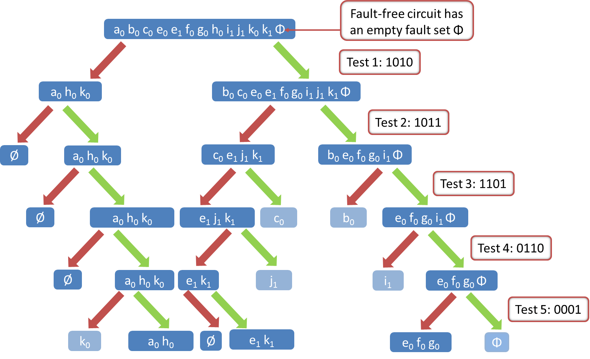
Diagnostic tree

Slide 83
Case study
Analyze the test responses and determine failures
# | Test pattern (abcd) | List of detected faults | Circuit under test
 |  |  | l | ll
1 | 1010 | a₀ h₀ k₀
2 | 1011 | c₀ e₁ j₁ k₁
3 | 1101 | b₀ e₁ j₁ k₁
4 | 0110 | e₁ i₁ k₁
5 | 0001 | e₀ f₀ g₀ k₀
Diagnosed faults

Slide 84
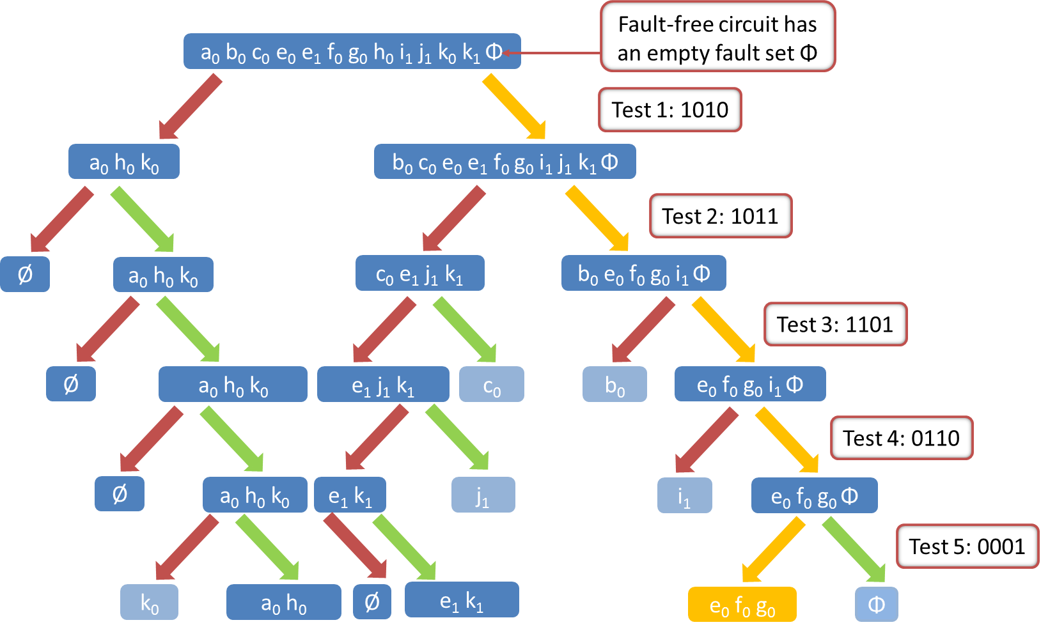
Diagnostic tree - circuit I

Slide 85
Case study
Analyze the test responses and determine failures
# | Test pattern (abcd) | List of detected faults | Circuit under test
 |  |  | l | ll
1 | 1010 | a₀ h₀ k₀
2 | 1011 | c₀ e₁ j₁ k₁
3 | 1101 | b₀ e₁ j₁ k₁
4 | 0110 | e₁ i₁ k₁
5 | 0001 | e₀ f₀ g₀ k₀
Diagnosed faults |  |  | e₀ v f₀ v g₀

Slide 86
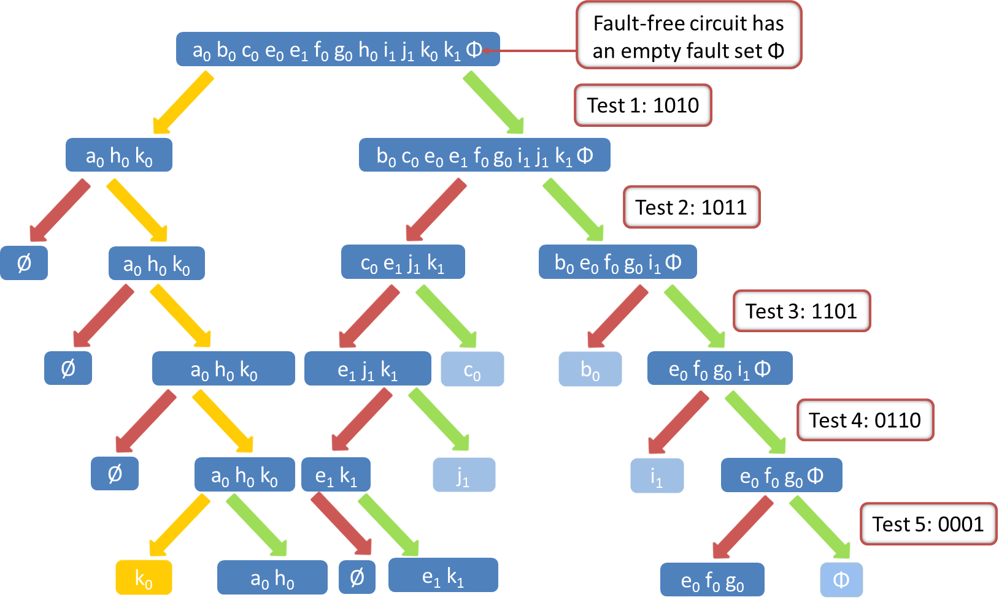
Diagnostic tree – circuit II

Slide 87
Case study
Analyze the test responses and determine failures
# | Test pattern (abcd) | List of detected faults | Circuit under test
 |  |  | l | ll
1 | 1010 | a₀ h₀ k₀
2 | 1011 | c₀ e₁ j₁ k₁
3 | 1101 | b₀ e₁ j₁ k₁
4 | 0110 | e₁ i₁ k₁
5 | 0001 | e₀ f₀ g₀ k₀
Diagnosed faults |  |  | e₀ v f₀ v g₀ | k₀

Slide 88
Improving the fault resolution
Generate tests to distinguish among faults: e₀ f₀ g₀
a
i
b
f
OR1
e
c
NOR1
k
AND1
g
j
d
h
d
OR2
NOT1
Consider 2 tests: 1001 and 0000
Save isolated test patterns and perform fault simulation

Slide 89
Fault simulation
Tessent FastScan run file: fs3.run
$TESSENT_PATH/tessent -shell \
-dofile fs3.do \
-log ./logs/fs3.log –replace
Tessent FastScan dofile: fs3.do
set_context patterns -scan
read_verilog ./netlist/c1.v
read_cell_library ../libs/atpg.lib
set_current_design c1
set_system_mode analysis
set_fault_type stuck // set stuck-at fault model
add_fault -all
set_pattern_source external ./patt/p6_e0f0_g0.ascii -ascii
Run // run fault simulation
report_statistics > ./patt/p6_e0f0_g0.fa
report_faults -class detected >> ./patt/p6_e0f0_g0.fa
reset_state
set_pattern_source external ./patt/p6_e0g0_f0.ascii -ascii
Run // run fault simulation
report_statistics > ./patt/p6_e0g0_f0.fa
report_faults -class detected >> ./patt/p6_e0g0_f0.fa
exit -d

Slide 90
Improving the fault resolution
Fault list report for test: 1001
0 DS /NOR1/OUT
1 EQ /NOR1/IN0
1 EQ /NOR1/IN1
1 EQ /b
1 EQ /c
0 DS /k
0 EQ /AND1/OUT
0 EQ /AND1/IN0
0 EQ /AND1/IN1
0 EQ /OR1/OUT
0 EQ /OR2/OUT
0 DS /OR2/IN0
F₁₀₀₁ = {e₀, g₀, k₀}
Fault list report for test: 0000
0 DS /NOR1/OUT
1 EQ /NOR1/IN0
1 EQ /NOR1/IN1
1 EQ /b
1 EQ /c
0 DS /k
0 EQ /AND1/OUT
0 EQ /AND1/IN0
0 EQ /AND1/IN1
0 EQ /OR1/OUT
0 EQ /OR2/OUT
0 DS /OR1/IN1
F₀₀₀₀ = {e₀, f₀, k₀}

Slide 91
Enhanced diagnostic tree
Φ e₀ f₀ g₀
Test 5: 0001
e₀ f₀ g₀
Φ
Test 6: 1001
e₀ g₀
f₀
Test 7: 0000
e₀
g₀
Test vectors 1001 and 0000 distinguish three faults and allow explicit location of their source

Slide 92
VLSI testing
LAB 9
Iterative Diagnosis
HEP

Slide 93
Iterative pattern generation
Invoke Tessent Diagnosis with the failure file from one device
Diagnosis run file: 1_iterative.run
$TESSENT_PATH/tessent -shell
-dofile 1_iterative.dofile
-log ./logs/1_iterative.log -rep
Diagnosis dofile: 1_iterative.dofile
set_context patterns -scan_diagnosis
read_flat_model netlist/tk_design.flat
set_diagnosis_options -bridge OFF -cell OFF
set_pattern_source external ./patt/pat.wgl -wgl
// run diagnosis
diagnose_failures fail1.log -output fail1.txt -rep
// create additional internal patterns
create_diagnosis_patterns -diagnosis_report fail1.txt
// save additional patterns
write_patterns ./patt/patt_iter.wgl -wgl -rep
exit -d

Slide 94
Iterative pattern generation
Analyze the diagnosis report
Diagnosis report: 1_iterative.log
#symptoms=2 #suspects=13 CPU_time=0.22sec fail_log=fail1.log
#failing_patterns=41, #passing_patterns=450
#unexplained_failing_patterns=19
4 37 57 65 86 103 110 116 187 196
208 268 271 274 275 305 310 315 336
symptom=1 #suspects=1 #explained_patterns=20
0 59 95 105 169 180 191 192 200 224
226 232 265 266 344 372 420 429 434 487
suspect score fail_match pass_mismatch type value pin_pathname cell_name net_pathname
-------------------------------------------------------------------------------------------------
1 96 20 0 OPEN/DOM both /DESTIN_DO[4] primary_output /DESTIN_DO[4]
-------------------------------------------------------------------------------------------------
symptom=2 #suspects=12 #explained_patterns=2
66 81
suspect score fail_match pass_mismatch type value pin_pathname cell_name net_pathname
-------------------------------------------------------------------------------------------------
1 91 2 0 STUCK 0 /cpu_i/uSDM/ix3179/Y nor03 /cpu_i/uSDM/nx3178
2 91 2 0 EQ1 1 /cpu_i/uSDM/ix3179/A0 nor03 /cpu_i/uSDM/nx2130
3 91 2 0 EQ1 1 /cpu_i/uSDM/ix3179/A1 nor03 /cpu_i/uSDM/nx2133
4 91 2 0 EQ1 1 /cpu_i/uSDM/ix3179/A2 nor03 /cpu_i/uSDM/nx2136
5 91 2 0 EQ1 1 /cpu_i/uSDM/ix746_ix17/Y aoi221 /cpu_i/uSDM/nx2130
6 91 2 0 EQ1 1 /cpu_i/uSDM/ix746_ix23/Y nor03 /cpu_i/uSDM/nx2133
7 91 2 0 EQ1 1 /cpu_i/uSDM/ix746_ix29/Y nor03 /cpu_i/uSDM/nx2136
8 91 2 0 EQ1 0 /cpu_i/uSDM/ix3171/A1 nor02_2x /cpu_i/uSDM/nx3178
9 91 2 0 STUCK 1 /cpu_i/uSDM/ix3171/Y nor02_2x /cpu_i/uSDM/nx3170
10 91 2 0 EQ9 1 /cpu_i/uSDM/ix625_ix13/A0 nand03 /cpu_i/uSDM/nx3170
11 91 2 0 STUCK 0 /cpu_i/uALU/modgen_or_2_ix11/B1 aoi221 /cpu_i/OPERAND_B_4
12 91 2 0 EQ11 0 /cpu_i/uALU/modgen_or_2_ix11/B0 aoi221 /cpu_i/uALU/nx2685
-------------------------------------------------------------------------------------------------
This failure has 2 symptoms and 13 suspects.
The first symptom is a failure on the primary output and it is clear that the failure is isolated.
Symptom number 2 has several suspects that have the same score. However, this failure has only 2 explained patterns so the resolution is limited. In this case it is good candidate for iterative diagnostics.

Slide 95
Emulation of the failure
Invoke Tessent Diagnosis with the following dofile which will emulate the failure and run the newly created iterative patterns
Diagnosis run file: 2_defect.run
$TESSENT_TREE/bin/tessent \
-shell \
-dofile 2_defect.dofile \
-log ./logs/2_defect.log -rep
Diagnosis dofile: 2_defect.dofile
set_context patterns -scan_diagnosis
read_flat_model ./netlist/tk_design.flat
set_diagnosis -bridge OFF -cell OFF
set_pattern_source external ./patt/pat_iter.wgl –wgl
// emulate the failure
write_failures ./fail2_iter.log -rep -cycle \ /cpu_i/uSDM/ix3171/Y -stuck 1
exit -d
This command emulates the failure and produces a new failure file

Slide 96
Diagnosis performance
Invoke Tessent Diagnosis with both created pattern sets and failure files
Diagnosis run file: 3_eval.run
$TESSENT_PATH/tessent -shell
-dofile 3_eval.dofile
-log ./logs/3_eval.log -rep
Diagnosis dofile: 3_eval.dofile
set_context patterns -scan_diagnosis
read_flat_model netlist/tk_design.flat
set_diagnosis -bridge OFF -cell OFF
// read pattern files
set_pattern_source external ./patt/pat.wgl -wgl
set_pattern_source external ./patt/patt_iter.wgl -wgl -append
// read failure files
read_failure ./fail1.log
read_failure ./fail2_iter.log -append
// perform the diagnosis
diagnose_failures -internal
exit -d

Slide 97
Diagnosis performance
Analyze the diagnosis report
Diagnosis report: 1_iterative.log
symptom=2 #suspects=6 #explained_patterns=34
66 81 498 504 516 530 537 547 553 561
562 577 579 584 589 592 597 600 602 610
616 634 635 641 666 676 680 686 697 708
710 725 727 736
suspect score fail_match pass_mismatch type value pin_pathname cell_name net_pathname
-------------------------------------------------------------------------------------------------
1 94 34 0 STUCK 1 /cpu_i/uSDM/ix3171/Y nor02_2x /cpu_i/uSDM/nx3170
2 94 34 0 EQ1 1 /cpu_i/uSDM/ix625_ix13/A0 nand03 /cpu_i/uSDM/nx3170
3 60 34 57 INDETERMINATE 0 /cpu_i/uSDM/ix625_ix13/Y nand03 /cpu_i/SFR_DATA_4
4 60 34 57 EQ3 0 /cpu_i/uAOM/ix552/A1 mux21_ni /cpu_i/SFR_DATA_4
5 53 34 98 INDETERMINATE 0 /cpu_i/uAOM/ix135_ix3/B1 ao22 /cpu_i/uAOM/nx551
6 53 34 98 EQ5 0 /cpu_i/uAOM/ix135_ix3/B0 ao22 /cpu_i/nx1277
-------------------------------------------------------------------------------------------------
After the iterative diagnosis only 6 suspects were reported for the symptom number 2

Slide 98
VLSI testing
LAB 10 Memory built-in self-test
HEP

Slide 99
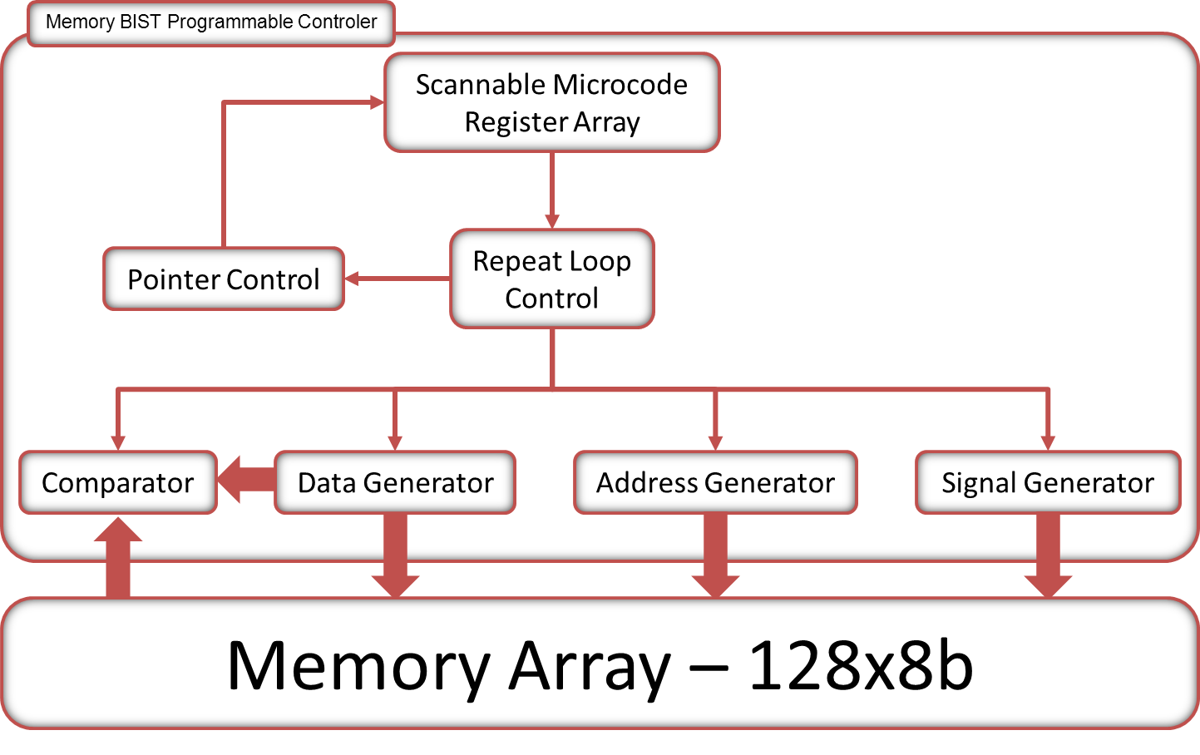
Memory BIST architecture

Slide 100
Data backgrounds for word memories
Use the programmable controller to generate multiple data backgrounds to detect all coupling faults between neighboring cells of the same word
Use the following data backgrounds:
D0
D1
D2
D3
D4
D5
D6
D7
B1
0
1
0
1
0
1
0
1
D0
D1
D2
D3
D4
D5
D6
D7
B2
1
0
1
0
1
0
1
0
Algorithm
# | Instruction
1 | ↑(wB1)
2 | ↓(rB1wB2)
3 | ↑(rB2)

Slide 101
User-defined algorithm
Modify the algorithm in the file to detect all possible coupling faults between neighboring cells in the word oriented memory
Algorithm syntax
Algorithm (<AlgorithmName>) {
TestRegisterSetup {
AddressGenerator {
…
}
DataGenerator {
…
}
}
MicroProgram {
Instruction (<InstructionName 1>) {
…
}
Instruction (<InstructionName 2>) {
…
}
…
}
}
Each Instruction wrapper
represents one micro code
word

Slide 102
User-defined algorithm
Address generator
AddressGenerator {
AddressRegister (A) {
LoadColumnAddress : 4'b0000;
LoadRowAddress : 4'b0000;
NumberY0Bits : 0;
NumberX0Bits : 0;
X1CarryIn : Y1CarryOut;
Y1CarryIn : none;
}
}
Data generator
DataGenerator {
LoadWriteData : 8'b01010101;
LoadExpectData : 8'b01010101;
}

Slide 103
User-defined algorithm
Instruction 1: ↑(wB1)
Instruction (Instr_1) {
OperationSelect : Write;
AddressSelectCmd : Select_A;
X1AddressCmd : Increment;
Y1AddressCmd : Increment;
WriteDataCmd : DataReg;
NextConditions {
X1_EndCount : On;
Y1_EndCount : On;
}
}

Slide 104
User-defined algorithm
Instruction 2: ↓(rB1wB2)
Instruction (Instr_2) {
OperationSelect : Read;
AddressSelectCmd : Select_A;
X1AddressCmd : Decrement;
Y1AddressCmd : Decrement;
ExpectDataCmd : DataReg;
InhibitLastAddressCount : On;
NextConditions {
X1_EndCount : On;
Y1_EndCount : On;
}
}

Slide 105
User-defined algorithm
Instruction 3: ↑(rB2)
Instruction (Instr_3) {
OperationSelect : Read;
AddressSelectCmd : Select_A;
X1AddressCmd : Increment;
Y1AddressCmd : Increment;
ExpectDataCmd : DataReg;
InhibitLastAddressCount : On;
NextConditions {
X1_EndCount : On;
Y1_EndCount : On;
}
}

Slide 106
Algorithm verification
Algorithm can be verified by dumping simulation data around the area of the fault-injected memory and the memory BIST controller
Invoke ModelSim algorithm simulation (makealg file) and analyze report to examine the number of compare failures.
Simulation report
Simulation Results Summary
--------------------------
Log File: ./outDir_etv/verilog.log_tapbistv
Date = Dec 15 11:21
# Number of Z Compare Events = 17
# Number of 1/0 Compare Events = 227
# Number of Compare Failures = 0
Log File: ./outDir_etv/verilog.log_membistpv_P1_top
Date = Dec 15 11:21
# Number of Z Compare Events = 0
# Number of 1/0 Compare Events = 37
# Number of Compare Failures = 2
The injected fault was correctly detected because there were 2 compare failures

